Slide 1
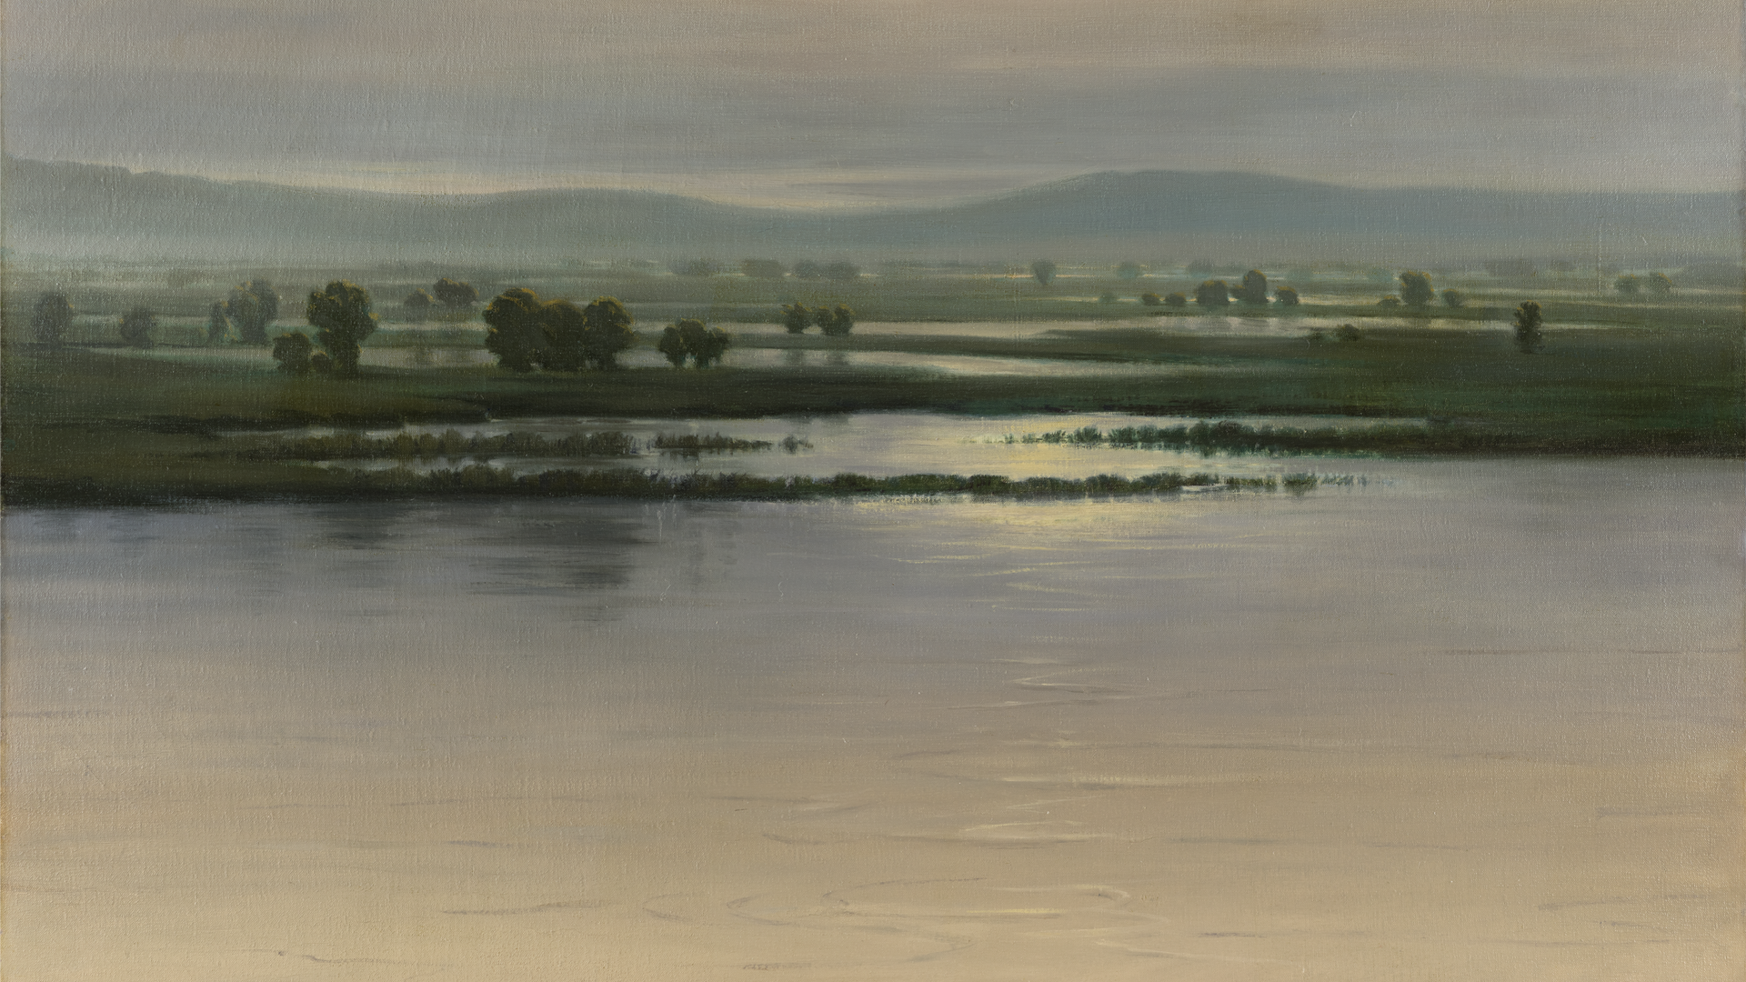


Slide 2
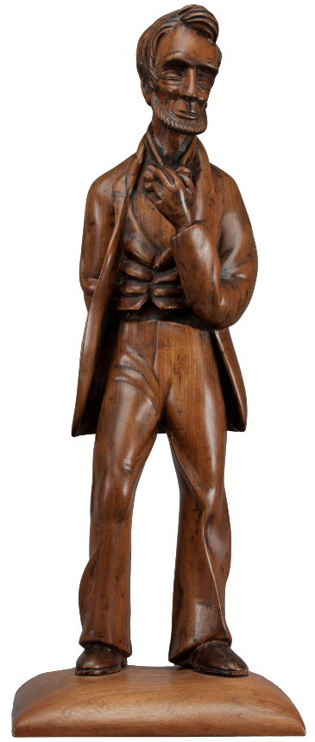
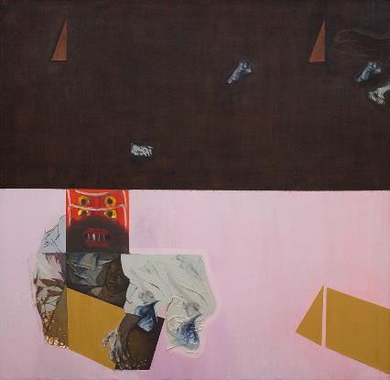
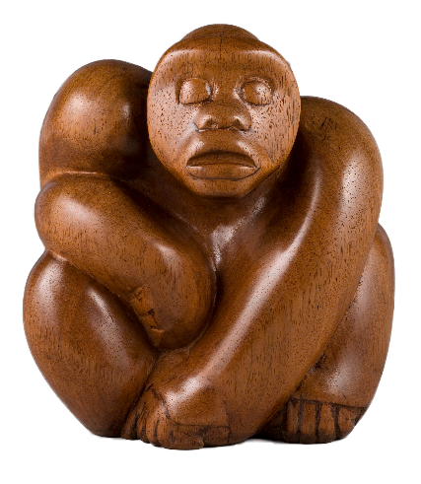
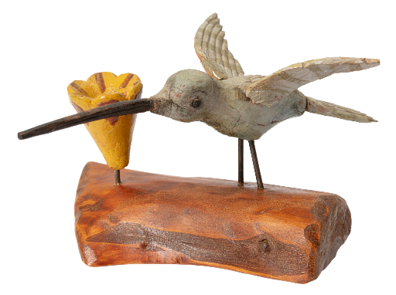
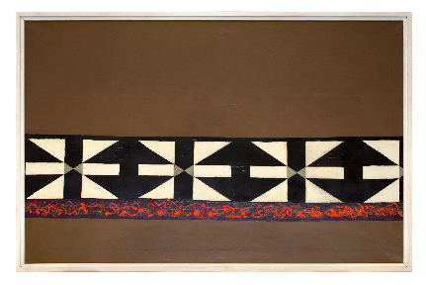
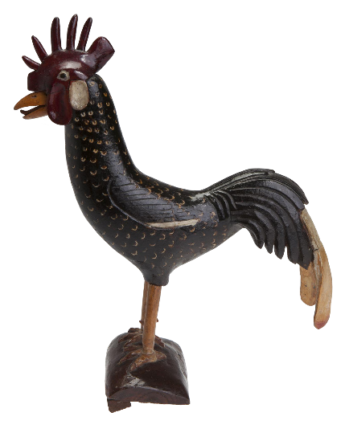
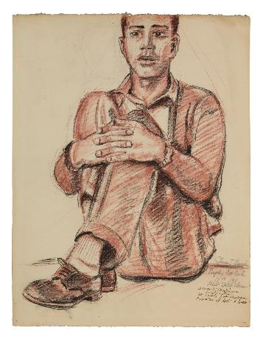
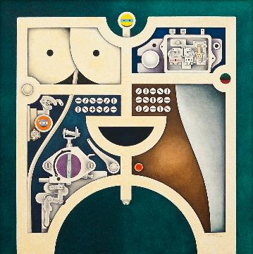
Art Communities
This resource section highlights a few of the artist personalities that defined artist communities in the confluence region, focusing specifically on artists who worked with the People’s Art Center and the Black Artists Group, as well as folk or outsider artists working at similar times. This section celebrates the local knowledge preserved by communities in the confluence region. By viewing these works as a group, they become members of one overarching community of makers compelled by their shared need to express their worlds though an artistic object. Every one of them speaks both to their local communities and to a broader national dialogue.

Slide 3
Consider and Discuss
As a class, explore the concept of community.
What do you think of when you hear the word community?
Create a class definition of “community.”
What does it mean to be a member of a community?
What brings people together in a community?
What might lead someone to join or identify with a community?
To be a community, must members like each other?
What might lead artists to create together in a community?
What are some different communities that you have been a part of (e.g. sports teams, school communities, neighborhoods)?

Slide 4
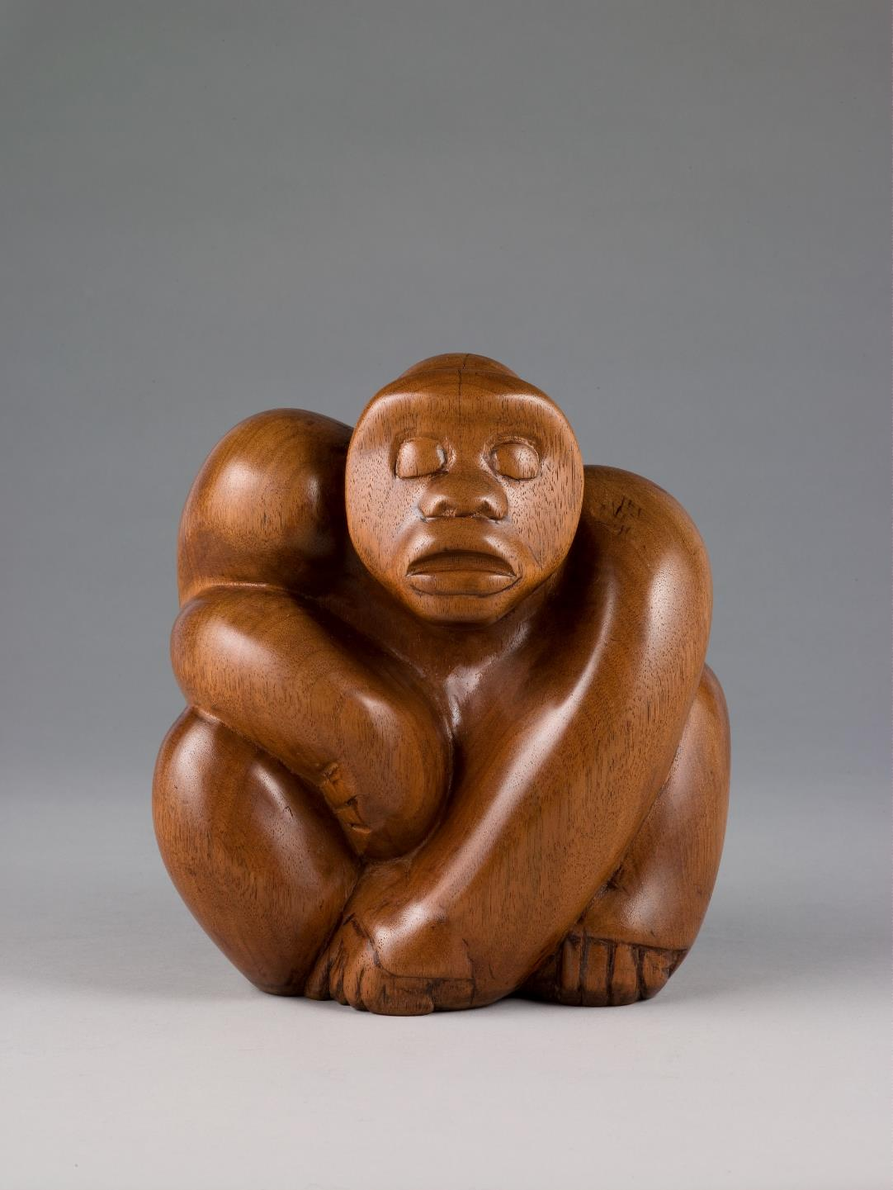

Slide 5
Looking Prompts
Using the name of the sculpture, Gorilla, create an acrostic poem about this artwork as you look at it. An acrostic poem uses each letter of a word as the beginning for a line in the poem. For example, here is an acrostic poem using the word cat:
Careful
Agile
Timid
What word would you use to describe the pose of this gorilla?
What are some other possible poses the artist could have chosen? Create these poses with your body if you are comfortable. Or draw them.
Why do you imagine the artist might have chosen to carve the gorilla in this pose?
Houston Chandler carved Gorilla out of wood. Imagine if this gorilla were made from a different material.
What would happen if it were made from stone?
How about if it were made from metal?
What if it were made from fabric and stuffed like a stuffed animal?
What material would you use if you were to make your own gorilla?
Houston Chandler, American, 1914–2015; Gorilla, c.1946; wood; 8 5/8 x 7 3/4 x 5 1/8 inches; Saint Louis Art Museum, Museum Purchase 1124:2010; © Houston Chandler
Notes:
About this artwork:
Muscular limbs compressed into a tight pose convey this gorilla’s physical power. The sophisticated incorporation of wood grain and reductive form attest to Houston Chandler’s artistic skill. In 1960, Chandler gave a lecture at the Saint Louis Art Museum about sculpting animals. He recommended visiting the St. Louis Zoo to get to know them up close. He wasn’t interested, however, in exactly replicating them but rather used abstraction to find what he described as “the simplicity that brings out the most powerful line of expression.”
Chandler taught sculpture and etching at the People’s Art Center. Having been the second African American to receive an MFA from the University of Iowa, he was one of the most highly trained instructors there. His sculpture, Gorilla, testifies to the level of artistry among the center’s staff.
In addition to the People’s Art Center, Chandler taught art at Vashon High School in St. Louis, which he had previously attended as a student. A talented athlete as well as an artist, Chandler coached numerous championship track and football teams in the area. Early in his tenure at Vashon, he drew the assignment of line coach for the varsity football team. The students were particularly surprised when he regularly beat them in sprint challenges.

Slide 6
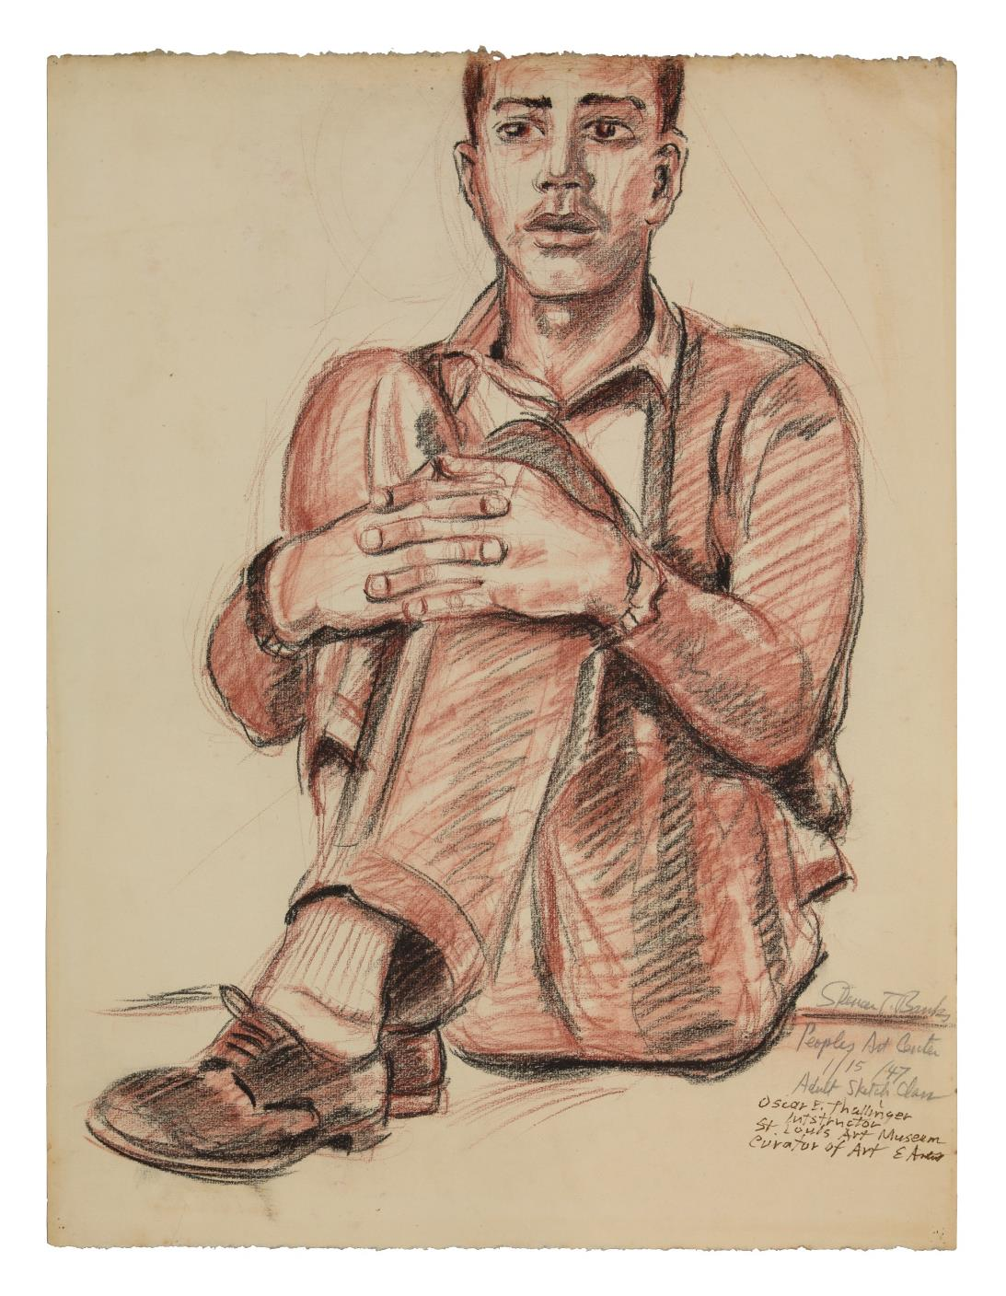

Slide 7
Looking Prompts
What is a feeling that comes to you as you look at this picture? What do you see that makes you say that?
Write a list of adjectives to describe what you see in this work of art.
Imagine the space where the person in this drawing may be sitting. Consider what they may be seeing or hearing.
Draft a story from the point of view of the figure.
What’s the setting?
What happened just before this moment?
Predict what might happen next in this story.
Assign a title to your story and add characters if necessary.
Spencer Thornton Banks, American, 1912–1983; Drawing from Adult Sketch Class, People's Art Center, 1947; red and black chalk on paper; sheet: 25 3/8 x 19 1/8 inches; George B. Vashon Museum 2021.4; © Estate of Spencer Thornton Banks
Notes:
About the Artwork:
Another longtime instructor at the People’s Art Center was Frederick Alston. Alston not only taught high school art, but also was the first cartoonist and art director for The St. Louis American newspaper. One of Alston’s students was the artist, Spencer Banks. Banks already had a career in commercial art, and in 1939 the St. Louis Argus ran his short-lived comic strip “Pokenia,” one of the first to feature an African American female lead. Even though he was an established artist, Banks signed up for the very first adult class offered by the People’s Art Center in 1942. Continuing his instruction there for nearly a decade, he garnered prizes in almost every local exhibition then available to African Americans in the St. Louis area.
The quick marks that render volume in his figure sketch are sensitively balanced with his perceptive evocation of the young model’s emotional presence, demonstrating why the artist was sought out for portrait commissions throughout his career.

Slide 8
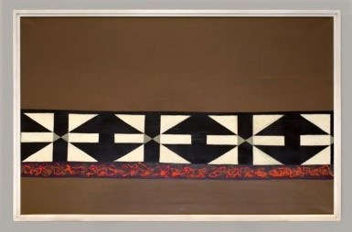

Slide 9
Looking Prompts
Explore the shapes of this painting. On a paper, draw different shapes that you find in the painting.
Notice simple shapes.
Notice complex shapes.
What happens when you combine shapes?
Explore positive space by finding the objects that appear in the front or feel the most dominant in the composition.
Explore negative space, the shapes that appear to be in the background, or are created in the space around those in the front.
Take the shapes that you have found and drawn on your paper. Cut them out. Trace them to create more of these shapes and then cut out these additional shapes. Arrange them in different patterns to create your own designs inspired by this painting. Add color to your image if you would like.
Claps, pats, foot taps, and other sounds can be created with our bodies and can be organized in a way that creates music. Look at this painting for 30 seconds. Then translate the rhythms and patterns of the artist’s design into your own sounds.
What shapes inspired your choices?
Emilio Cruz, American, 1938–2004; Untitled, 1972; acrylic on canvas; 40 x 62 inches; The John & Susan Horseman Collection 2021.7; © Patricia Cruz / Estate of Emilio Cruz
Notes:
About the Artwork:
A band of black and white patterns melds geometric abstraction with generalized African shield and mask forms. These two interests express the merging of European avant-garde and African art at the heart of BAG.
Emilio Cruz, a New York Afro-Cuban artist, came to St. Louis in 1969 as BAG’s visual artist-in-residence. He participated in the group’s performances and taught at its center and in the nearby Pruitt-Igoe housing project. He also led college workshops and neighborhood art projects, embracing the opportunity to “work with Black people [on] our own way of saying things.”

Slide 10


Slide 11

Looking Prompts
What do you notice about the colors in this painting?
How do you imagine the painting would feel to you if the artist used warm colors, such as reds and yellows?
What do you imagine the painting would feel like if the artist used only black and white?
If the painting were hung upside down, how would your observations change?
What associations come to mind when you look at this painting?
What sounds do you imagine this painting would make?
What movements might you see if this painting were to come to life?
If only one element had the ability to move in this painting, what part would move? Why?
Manuel Hughes, American, born 1938; Untitled, 1971; oil on canvas; 36 x 36 x 1 inches; Saint Louis Art Museum, Gift in memory of Saul A. and Dorothy Pearlstein Dubinsky from their children 616:1998; © Manuel Hughes
Notes:
About the Artwork:
Machinery and human form merge in this image. Much of Manuel Hughes’ work contested damaging stereotypes while celebrating Black culture. As he explained, “Everyone was focused on the political struggle during the late 1960s and early 70s....I was doing Black imagery to reinforce what Black people were feeling at that time.”
Curious from walking past the People’s Art Center on his way to school as a child, Hughes enrolled himself in a class. Later, several musician friends introduced him to the Black Artists’ Group, and he worked and exhibited with other members.

Slide 12


Slide 13

Looking Prompts
Use Visual Thinking Strategies (VTS) to explore this painting:
What’s going on in this picture?
What do you see that makes you say that?
What more can you find?
What aspects of the painting help us understand its mood?
As a class, build a list of things that you find in this image, such as colors, shapes, and imagery.
Using the list created collaboratively as a class, build a narrative (individually or as a group) inspired by the elements discovered from the painting.
Oliver Lee Jackson, American, born 1935; Painting II, 1969, 1969; oil-based pigments and mixed media on canvas; 66 1/2 x 66 1/2 inches; Courtesy of the artist 2021.12; © Oliver Lee Jackson
Notes:
About the Artwork:
Oliver Lee Jackson participated in BAG events, but his greatest influence on the group may have been his engagement with pan-African concepts, which he had honed as an instructor in the Southern Illinois University’s Experiment in Higher Education program (EHE). Partnered with dancer Katherine Dunham’s Performing Arts Training Center in East St. Louis, EHE was an incubator for the emerging field of Black studies. The apex of BAG-associated events
was Jackson’s Images: Sons/Ancestors, a multimedia, pan-African “concert-ritual prayer” held in 1971 at the newly renovated Powell Hall, which challenged the exclusion of African-centered artistic forms from such traditional venues. The following year BAG dissolved, as its core musicians left to find a foothold in the New York jazz scene.
In Painting II, 1969, a striking, red mask looks out over an abstracted image of a box. Representations of figural elements and body parts are on view in different parts of the image. This imagery questions conventions of Western figure painting, such as its dependence on the illusion of three-dimensional form, by abstracting the body and incorporating non-European masks.

Slide 15
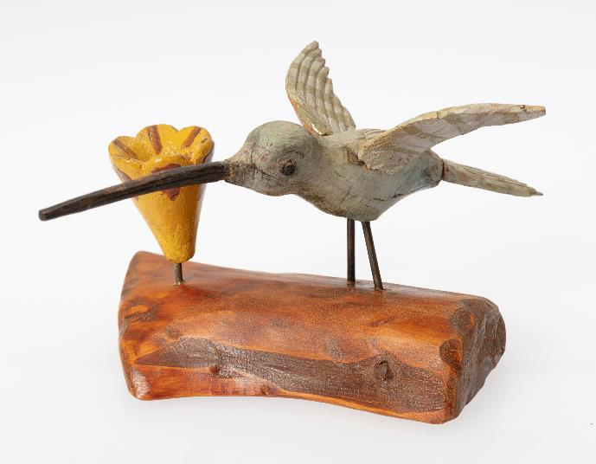
Looking Prompts
When looking at these two sculptures, what do you notice first?
If you could create a home for these two birds, where would it be and why?
If you were able to observe the birds in the same location, would they interact with one another or remain separate?
Describe their movements within the location you have imagined. What can you find in the artwork to support your answers?
If you could spend a day with one of these birds, what might you learn?
Imagine it was able to fly. Where would it travel? Draw a map of its travels.
What clues can you discover to possibly help identify what type of bird this might be?
Compare the clues you discovered with images and information about birds that you can find in research resources such as books or websites. You may want to begin by exploring this All About Birds online guide.
Frederick "Fritz" Baurichter, American (born Germany), 1850–1937; Hummingbird, c.1904-10; painted wood; bird only: 3 3/4 x 5 1/4 x 6 inches; Courtesy of the Missouri Historical Society, St. Louis 2021.51
Frederick "Fritz" Baurichter, American (born Germany), 1850–1937; Rooster, c.1904-10; painted wood; 13 x 11 1/2 x 4 1/2 inches; Courtesy of the Missouri Historical Society, St. Louis 2021.50
Notes:
About the Artwork:
Wood has long been a favored material for folk artists due largely to its ease of carving. These whimsically carved and painted sculptures capture their subjects in lively poses. The hummingbird alights on a wood base, with raised wings and long beak exploring a flower. The rooster stands erect with long tailfeathers and curled tongue, crowing through his open beak.
German immigrant Fritz Baurichter had experience carving as a gunsmith and was inspired by a visit to the 1904 St. Louis World's Fair to try his hand at sculpture. The folk artist created small works as gifts, carving each with charm and a sophisticated sense of design.

Slide 16
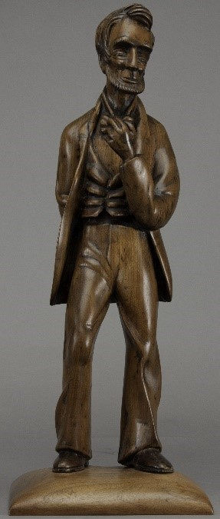
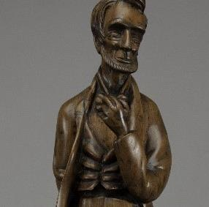

Slide 17
Looking Prompts
What might the pose suggest about the figure’s mood?
What might be the figure’s next movement?
What visual clues help identify this
well-known figure in U.S. history?
Imagine the figure begins to speak.
What might his first words be?
What would you want to ask him? Write a list of questions.
Imagine how he might respond.
What in the work of art gives you clues to how he might respond?
With a partner or small group, act out or write the conversation.
Fred E. Myers, American, 1910–1950; Lincoln, 1929; wood (railroad tie); 26 1/2 x 10 1/4 x 9 inches; University Museum, Southern Illinois University Carbondale 2021.39
Notes:
About the Artwork:
Southern Illinois folk sculptor Frederick Myers worked in wood, with a remarkable sensitivity to its grain and natural growth. Myers quit school at age 16 to work in the area’s coal mines. When they closed during the Great Depression, he sculptured prehistoric animal displays for Southern Illinois University while working for the WPA (Works Progress Administration). He never thought of himself as anything other than a coal miner, however, and turned down several art-related jobs in Chicago.
In his sculpture, Lincoln, Abraham Lincoln grasps his tie, his coat casually open. Myers carved Lincoln from a railroad tie taken from the coal mine and captured Lincoln’s distinctive features with sensitivity to the wood’s natural grain. Unable to afford sandpaper, he used a glass shard to polish the surface to a high sheen.

