Slide 1
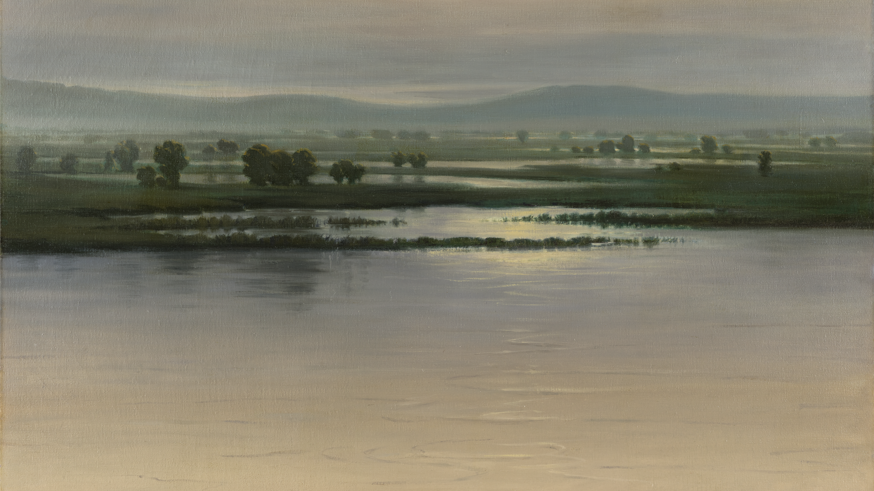


Slide 2

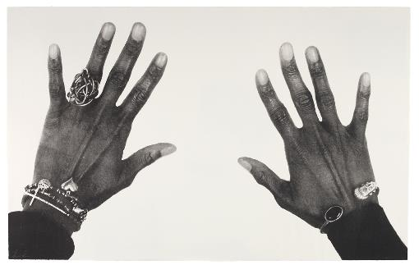
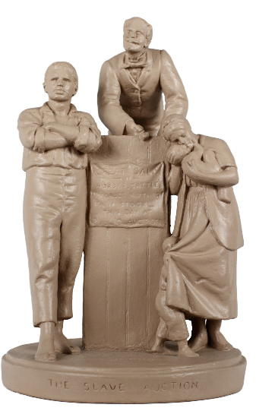
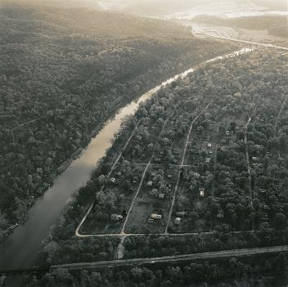
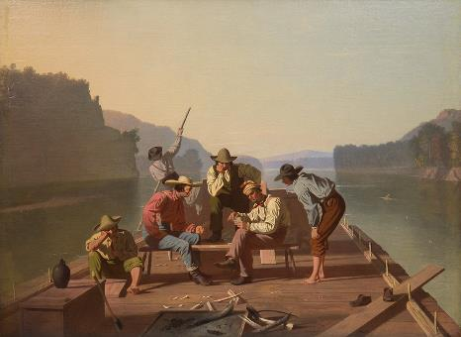
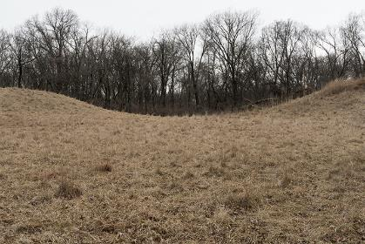
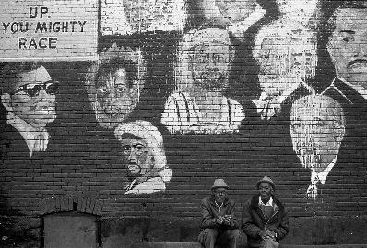
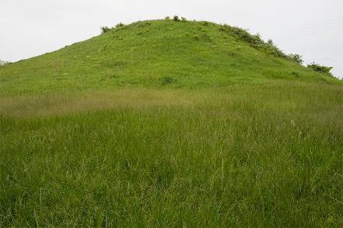
Art as Advocate
Artworks in this section advocate by drawing attention to politics, people, and places. Some have communicated support for political policies or promoted recognition of people from marginalized groups. Others have countered social injustices or investigated relationships between humans and nature. All speak boldly in the hopes of effecting change.

Slide 3
Consider and Discuss
How can artwork accomplish a goal, solve a problem, or make a statement?
In what ways do artists advocate through art?
How do artists and objects advocate for political, social, or environmental viewpoints?
What is the relationship between art and activism? In what ways can you creatively advocate for change?

Slide 4
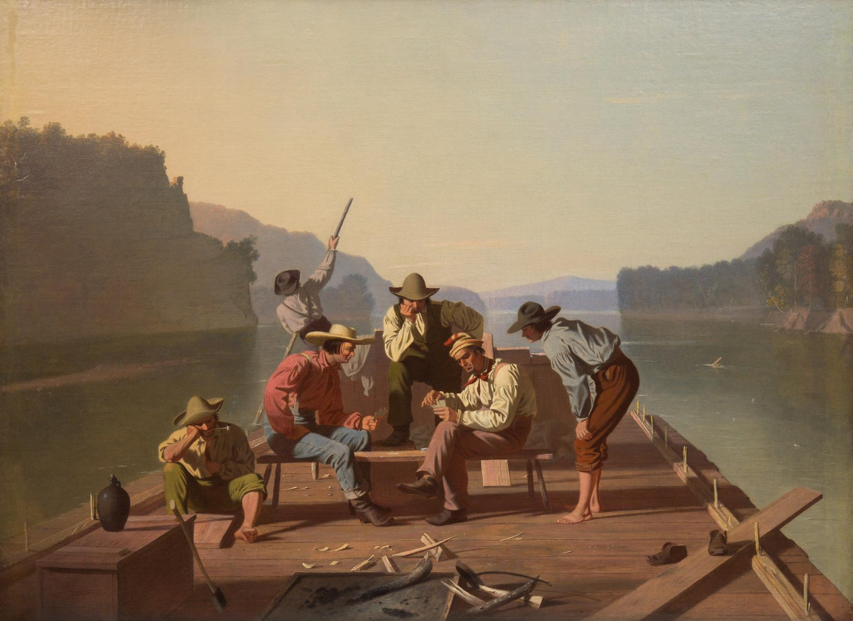

Slide 5

Looking Prompts
Imagine you are sitting or standing on the raft with the people pictured. Where would you like to be on the raft? What might you see if you look in different directions? What do you imagine it would feel like to be on the raft?
Now, imagine you are on the end of the raft facing the people we see in the painting. Explore with your senses.
What do you see?
What can you hear?
What do you smell?
What does the weather feel like on your skin?
As you gaze across the flat surface of the water, what do you notice?
As a follow up to the questions above, ask What do you see that makes you say that?
If you could ask any of the people in this scene a question, who would you ask and what would you like to ask them?
George Caleb Bingham, American, 1811–1879; Raftsmen Playing Cards, 1847; oil on canvas; 28 1/16 x 38 1/16 inches; Saint Louis Art Museum, Bequest of Ezra H. Linley by exchange 50:1934
Notes:
About this artwork
While at first glance this appears to be an idyllic river scene, dangers lurk in the background. A sandbar lies menacingly to the left, and a “snag,” or fallen tree, punctures the river’s surface to the right. Both features were capable of wrecking rafts and steamboats alike, serious impediments to the future of commerce on both the Mississippi and Missouri rivers.
George Caleb Bingham was primarily a self-taught artist who spent much of his childhood in Franklin, Missouri. Fascinated by people and places along Missouri’s rivers, Bingham captured many scenes of river life in the later half of the 1800s. Both an artist and politician, he often used his paintings to lobby for commerce and investment in his home state of Missouri.
Raftsmen Playing Cards depicts a quiet moment of leisure among six raftsmen aboard a simple raft. The raftsmen had the job of transporting goods from sites of production to commerce destinations via rivers such as the Mississippi and Missouri. Exhibited first in St. Louis and then in New York City in 1847, Raftsmen Playing Cards conveyed two messages. One was directed mostly to its national audience: in sharp contrast to the typical image of river laborers, who were frequently portrayed as vulgar, violent characters, Bingham’s raftsmen appear clean and collegial—civilized folks who could be trusted to uphold the pursuits of the nation.
Raftsmen Playing Cards also participated in a national debate central to Missouri politics at the time. Throughout the 1840s, Bingham and other Whig politicians advocated for the federal government to fund the cleanup of the Mississippi and Missouri Rivers as part of their desire to integrate Missouri more fully into the national economy. As this vision relied on rivers to move goods from their places of production in the West to their markets in the East, any threat to river commerce took on outsized importance. In Raftsmen Playing Cards, Bingham demonstrates a principal impediment to navigation: trees that have toppled from the sandy banks into the river lodge in its bottom, creating large “snags,” seen at the right of the painting. In showcasing these snags and other dangers on a national scale, Raftsmen Playing Cards advocated for the cleanup of these rivers with federal funds.
In 1847, Bingham exhibited a second painting, Lighter Relieving A Steamboat Aground showing the result of such obstructions: a steamboat has wrecked on a sandbar, necessitating the rescue of its passengers and cargo. Together, these two paintings offer a pointed rebuke to critics of federal intervention, such as President James Polk, who had repeatedly vetoed a bill to clear the rivers, by showing the results of their inaction.

Slide 6
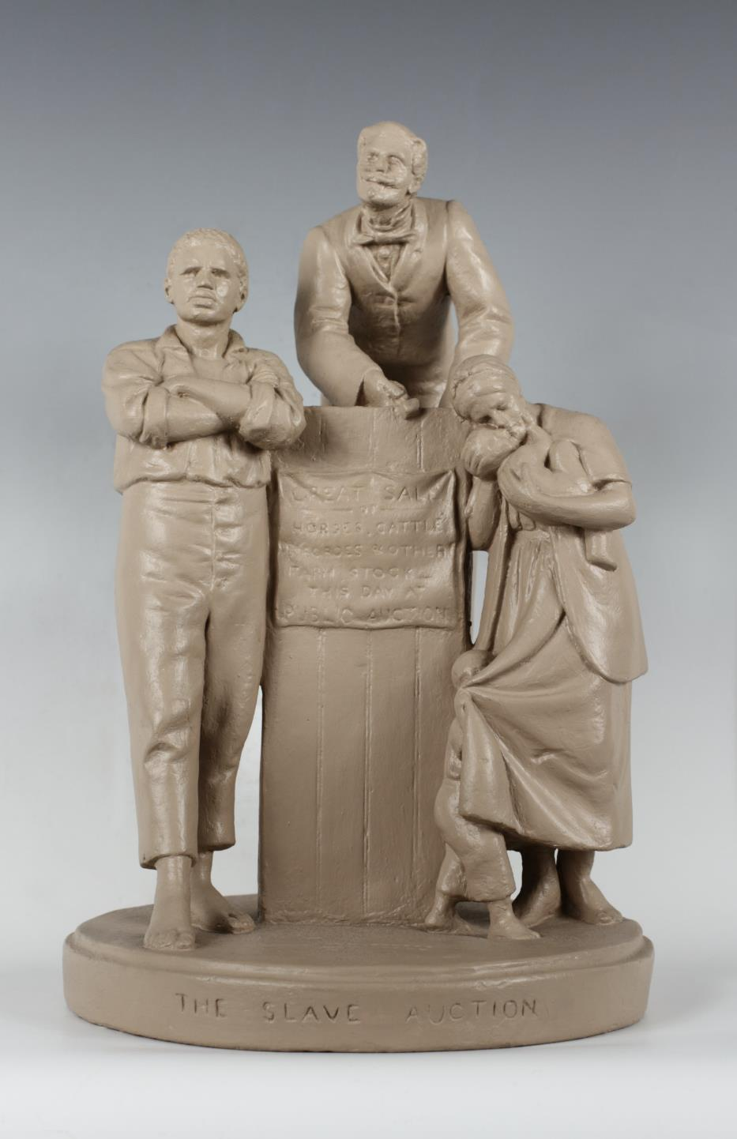

Slide 7
Looking Prompts
What’s going on in this sculpture?
What do you see that makes you say that?
What more can you find?
Consider each figure in the sculpture:
What do you notice about their pose?
How would you describe their facial expression?
What is one word you would use to describe their mood or emotion?
What do you wonder about as you look at this sculpture?
John Rogers, American, 1829–1904; The Slave Auction, 1859; painted plaster; 13 1/4 x 9 inches; Albany Institute of History & Art, gift of Mrs. Ledyard Cogswell, Jr., from the Benjamin Walworth Arnold Collection 2021.205
Notes:
About the Artwork:
A family is about to be torn apart in a tragic outcome of chattel slavery, where human beings were denied agency and treated as property. The auctioneer’s hair curls into devil horns, revealing his evil character. This tabletop sculpture, an icon of the abolitionist cause, was created following John Rogers’s 18-month residence in Hannibal, Missouri, where he had worked from 1856 to 1857 as a master mechanic for the Hannibal and St. Joseph Railroad. As he expressed to his family of “rank abolitionists” in Massachusetts, “the curse of slavery is dreadfully apparent here.” While Rogers did not write about attending a slave auction in Missouri, such sales occurred with regularity in Hannibal and neighboring cities as part of the national slave-trading network. Rogers’s first and only experience of living in a state where slavery was legal brought about a new consciousness; as he remarked during his residence in Missouri in reference to President Franklin Pierce’s opposition to the abolitionist movement, “I am not much of a politician—I never was. . . But I begin to see how things really are now.” The Slave Auction “touched the conscience of a nation,” as a critic later wrote, and became an abolitionist icon, due to its display in the office of the National Anti-Slavery Association in New York City and its frequent reproductions in the abolitionist press.

Slide 8
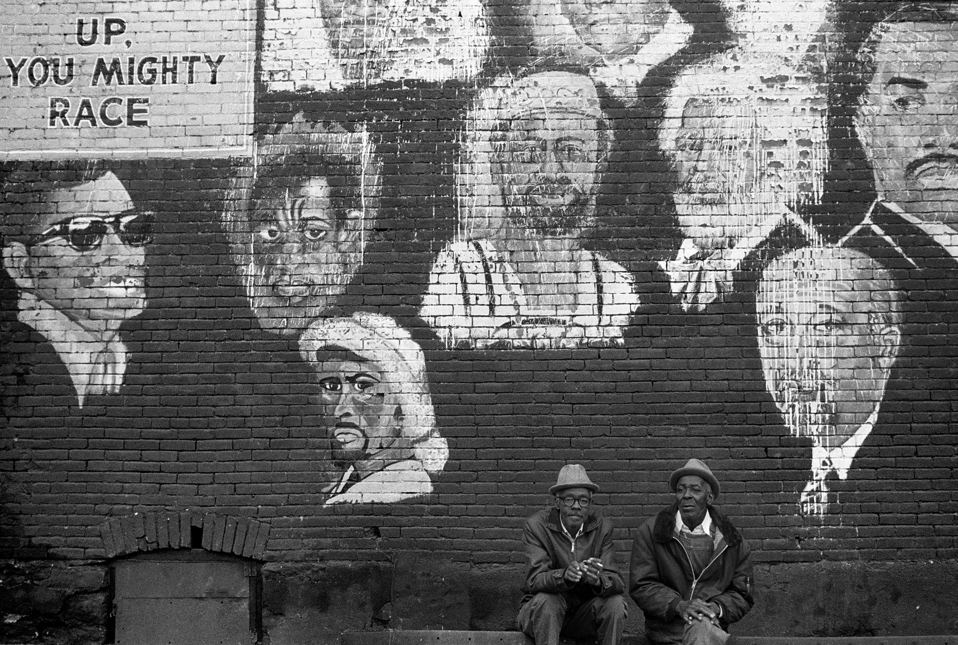

Slide 9

Questions for Looking
What do you see as you look at this photograph?
What do you think about that?
What does it make you wonder about?
Ken Light, American, born 1951; Race Wall, St. Louis, Missouri, 1971, printed 1999; gelatin silver print; image: 12 1/2 x 18 3/4 inches, sheet: 16 x 20 inches; Saint Louis Art Museum, Gift of August A. Busch Jr., by exchange 39:2021; © Ken Light
Notes:
About the Artwork:
Two men sit below painted portraits of Black leaders. This photograph documents one of St. Louis’s most important community-based art projects: a three-story mural created in 1968 by volunteers from local civil rights groups.
In 1967, a mural celebrating African American achievement, known as the Wall of Respect, was painted in Chicago, sparking a nationwide movement of similar urban murals that powerfully demonstrate how art can advocate for its communities. By 1975, the Chicago mural had sparked over 1000 murals across the United States, primarily painted by BIPOC artists.
In 1968, volunteers from St. Louis civil rights groups joined together to paint a Wall of Respect on a three-story building at 2800 Franklin Avenue, near the Pruitt-Igoe housing project and the headquarters of the Black Artists’ Group. Photographer Ken Light documented the wall in 1971.
Organized by Luther Mitchell and painted by Leroy White, Walter Friday, and five other artists whose names we have yet to identify, the wall was intended to “bring on Black awareness and Black consciousness of Black history,” as one community leader announced. It memorialized 16 Black leaders, seven of whom—Ray Charles, James Baldwin, Jean Baptiste Pointe du Sable, LeRoi Jones, Frederick Douglass, W. E. B. Du Bois, and the Rev. Dr. Martin Luther King—are pictured in Light’s photograph alongside a version of Marcus Garvey’s exhortation “Up, you mighty race.” On other parts of the mural not visible in Light’s photograph, there were portraits of Phyllis Wheatley, Muhammad Ali, and St. Louisan Dick Gregory, among others. The wall quickly became, in the words of one supporter, “a gathering place for meetings and performances” and “a symbol of Black achievement and determination.” In Light’s photograph, two Black individuals sit in the midst of these heroes, suggesting they also embody Black excellence. But the mural also became a target: it was vandalized at least twice, once just weeks after its creation and again in January 1969. The artists later returned to the wall and restored elements of the portraits that had been defaced. The photograph documents the four-year-old mural scarred by this hatred, with white paint partially effacing several portraits. Despite such acts, the mural held a central place in its community for over a decade before the building on which it was painted fell into disrepair and was demolished. For poet Eugene Redmond, the Wall of Respect was “Built so Blacks can see their (Blackness) tower.”

Slide 10
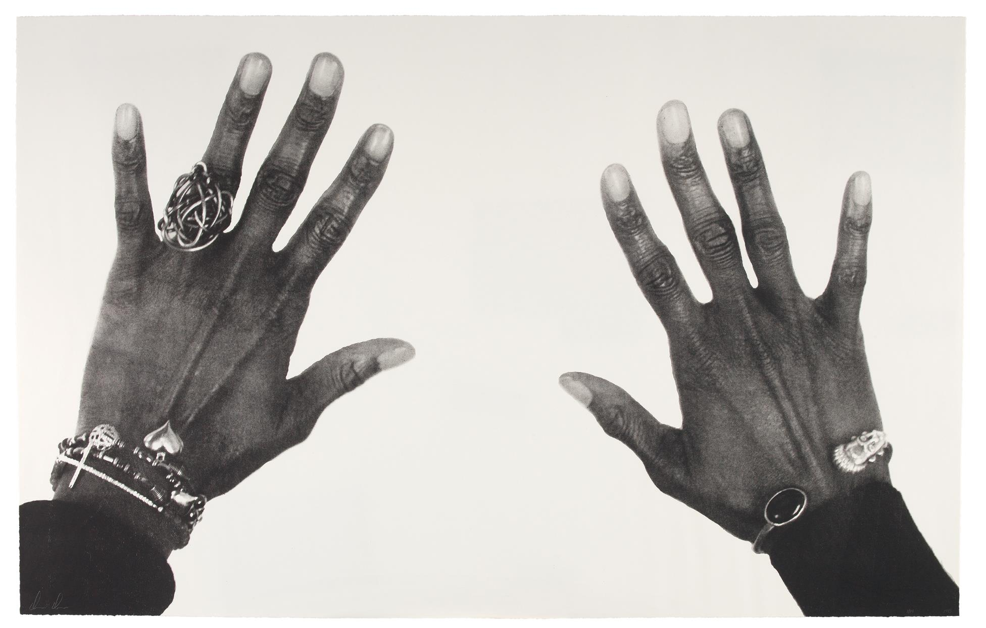

Slide 11
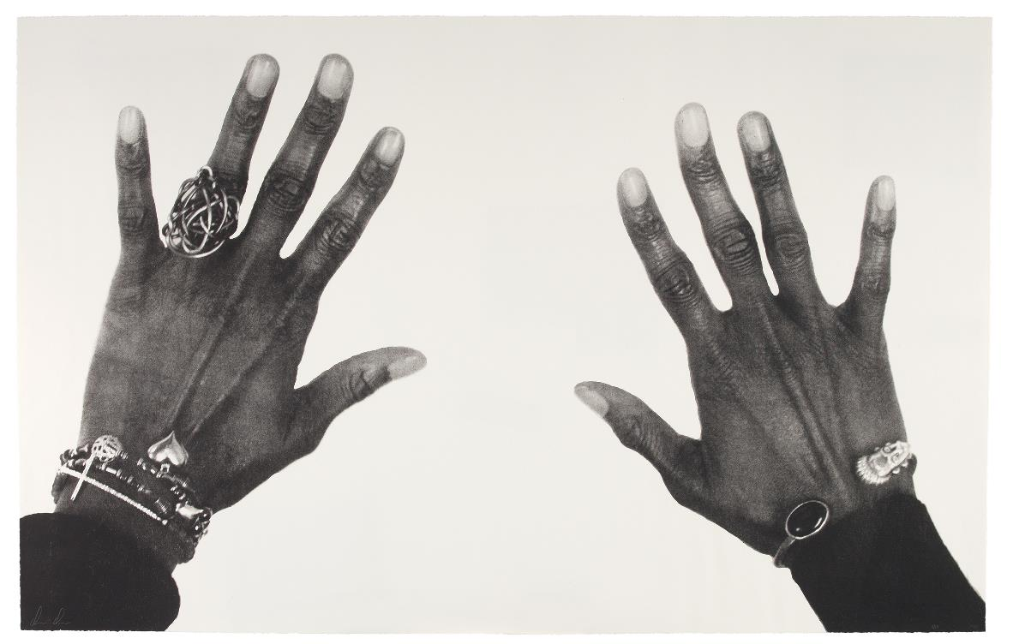
Looking Prompts
Look closely at this work of art. What do you discover as you look?
Write a list of 10 nouns or adjectives that describe what you see.
What details emerge as you continue to look?
How would the impact of this image change if it were very small? Or if it were very large?
What if you were to change the background?
What else do you notice about the composition of this image?
Damon Davis, American, born 1985; All Hands on Deck #5, 2015; lithograph; sheet (irregular): 32 x 50 13/16 inches; Saint Louis Art Museum, The Sidney S. and Sadie Cohen Print Purchase Fund 9:2016.5; © Damon Davis
Notes:
About the Artwork
What do hands and their gestures reveal?
This image of hands originated in the protests after Michael Brown Jr. was shot and killed by a police officer in Ferguson, Missouri, on August 9, 2014. Artist Damon Davis, an active member of the Ferguson protest movements, chose seven fellow protesters from diverse backgrounds as his subjects. He photographed just their hands, help up in a gesture that echoes the phrase “hands up, don’t shoot” heard throughout the uprisings. By titling the project All Hands On Deck, however, Davis transformed a gesture of surrender into one of solidarity, community, and above all a call for change.
The photographs were originally printed in large scale and pasted onto boarded-up storefronts during the Ferguson protests. In Davis’ own words: “The project in itself was a protest to change the physical space of the street in the aftermath of the murder of Michael Brown. The boarded-up buildings created a narrative of destruction before anything had even happened, and that fed into the media’s biased portrayal of the protesters. It was a way to weaponize art to create a counter-narrative centered on the unity and love I saw every time I went out to protest. It sought to raise the morale of the protest community to continue the long fight.” The print in this resource is part of a series of lithograph prints created from Davis’s photographs, which were published in a limited edition by Wildwood Press in St. Louis.
Davis’ multidisciplinary practice spans film, music, sculpture, photography, and print media. According to Davis, “My work is rooted in the Black American experience because that is my experience. I am motivated by how I internally process the idea of race and how it has personally affected my life, as well as the larger socio-political implications of race in America and the world.”

Slide 12


Slide 13

Looking Prompts
Before reading any information about this artwork, look closely at the image.
If you were the artist, what title would you give it? What about it makes you choose that title?
If you were asked to choose a song to go along with this image, what song would you choose?
What more can you find as you look at this image?
Emmet Gowin, American, born 1941; The Abandoned and Condemned Village of Times Beach, Missouri, 1989; gelatin silver print; image: 9 5/8 x 9 3/4 inches, sheet: 11 x 14 inches; Saint Louis Art Museum, Gift of Emmet and Edith Gowin in honor of Eric Lutz 26:2021; © Emmet Gowin
Notes:
About the Artwork:
Times Beach, Missouri, suffered one of the nation’s largest environmental disasters. Located about 17 miles southwest of St. Louis along the Meramec River, the town of Times Beach was founded in 1925 as a weekend resort community and by the 1970s, it was home to about 2,500 year-round residents. In 1982, the town was declared uninhabitable after a contractor sprayed the town’s roads with the toxic chemical dioxin in order to suppress dust. Following its designation as an EPA Superfund site, it was entirely evacuated by 1985.
Emmett Gowin included the site in a series of aerial photographs that recorded places where humans have radically altered landscapes, including nuclear test sites, missile silos, coal mines, and more. The Abandoned and Condemned Village of Times Beach, Missouri, which looks east into the early morning light, appears peaceful and serene. Lush foliage and a tidy grid of streets betray no trace of the toxic chemicals lurking there. Following the evacuation, the land appears to be returning to nature. The photograph seems to exemplify Gowin’s astonishment that, as he described, “in spite of all we have done, the earth still offers back so much beauty, so much sustenance. So much of what we need is embodied in it.” For him, such pictures became “an opening through which to seek what we don’t know, or already know and should take seriously.” In the case of Times Beach, this responsibility means attending to both the careful management of hazardous materials and the ongoing physical, psychological, social, and economic impacts on its former residents.

Slide 14
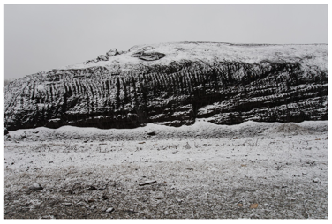
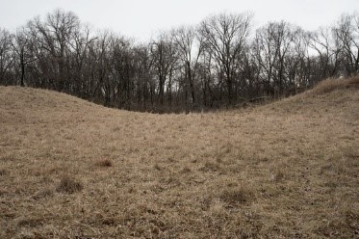
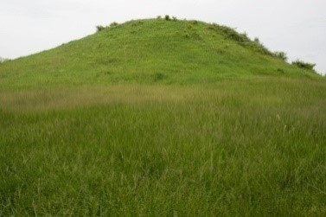

Slide 15
Looking Prompts
Compare and contrast these three images.
What is similar about each of the landscapes? What is different?
If you could choose one of these images to teleport into, which one would you choose?
What caused you to choose that one?
Where would you want to land in the image?
What would you want to have with you if you were in this landscape?
Jennifer Colten, American, born 1962; Mound 2484, from Significant and Insignificant Mounds, 2018; archival pigment print; image: 26 1/2 x 40 inches, sheet: 30 1/2 x 44 inches; Courtesy of the artist 2021.101; © Jennifer Colten
Jennifer Colten, American, born 1962; Mound 7158, from the project Significant and Insignificant Mounds, 2017; archival pigment print; 26 1/2 x 40 inches; sheet: 30 1/2 x 44 inches; Saint Louis Art Museum, Courtesy of the artist 2021.100; © Jennifer Colten
Jennifer Colten, American, born 1962; Mound 7040, from the project Significant and Insignificant Mounds, 2017; archival pigment print; 26 1/2 x 40 inches; sheet: 30 1/2 x 44 inches; Saint Louis Art Museum, Courtesy of the artist 2021.99; © Jennifer Colten
Notes:
About the Artwork
A family is about to be torn apart in a tragic outcome of chattel slavery. The auctioneer’s hair curls into devil horns, revealing his evil character. The confluence region in Missouri held many such auctions, part of a national slave-trading network.
This tabletop sculpture, an icon of the abolitionist cause, followed John Rogers’s 18-month residence in Hannibal, Missouri, where he had worked from 1856 to 1857 as a master mechanic for the Hannibal and St. Joseph Railroad. As he expressed to his family of “rank abolitionists” in Massachusetts, “the curse of slavery is dreadfully apparent here.” While Rogers did not write about attending a slave auction in Missouri, such sales occurred with regularity in Hannibal and neighboring cities as part of the national slave-trading network. Rogers’s first and only experience of living in a state where slavery was legal brought about a new consciousness; as he remarked during his residence in Missouri in reference to President Franklin Pierce’s opposition to the abolitionist movement, “I am not much of a politician—I never was. . . But I begin to see how things really are now.” The Slave Auction “touched the conscience of a nation,” as a critic later wrote, and became an abolitionist icon, due to its display in the office of the National Anti-Slavery Association in New York City and its frequent reproductions in the abolitionist press.

