Slide 1

The Work of Art:
Delivered
Art Resource and Engagement Kit

Slide 2
About the Resource
This resource, The Work of Art: Delivered, is designed to help foster classroom engagement with artworks created by artists who participated in the Federal Art Project from 1935-1943. The artwork selection and conversation prompts have been designed with youth in mind. You may adapt to other audiences and age groups in whatever ways are most appropriate.
The resource features 14 images. Nine were created by children at the LeMoyne Art Center in Memphis, Tennessee, and five were created by adult artists employed at different Works Progress Administration (WPA) sites around the United States.
This resource has been created in conjunction with the exhibition The Work of Art: The Federal Art Project, 1935-1943, on view at the Saint Louis Art Museum August 2, 2024-April 13, 2025. The artwork included is a part of the Museum’s collection, and we encourage you to continue to utilize these resources even after the exhibition closes.

Slide 3
About the Exhibition
The Work of Art: The Federal Art Project, 1935–1943 is on view until April 13, 2025 at the Saint Louis Art Museum.
During the Great Depression, President Franklin D. Roosevelt’s New Deal initiated a series of nationwide support programs for the arts. The largest program, the Federal Art Project (FAP) of the Works Progress Administration (WPA), put more than 10,000 artists to work. Their art, in turn, decorated municipal spaces, circulated through exhibitions, and was distributed to institutions across the United States. In 1943 the Saint Louis Art Museum received 256 prints, drawings, watercolors, and paintings. Around half of those were intended for use in educational programs at the People’s Art Center, the city’s first interracial community art center.
The FAP sought to broaden opportunities to create and encounter art. Funding supported artists active in many different communities, some of whom had historically not received such assistance. The Museum’s allocation includes significant works by Asian American, Black, female-identifying, and immigrant artists.
Between 1935 and 1942, the FAP opened offices throughout the United States. Within the Federal Art Project, artists pursued their own ideas about making art, enabling them to share their personal viewpoints and experiences. From the vantage of St. Louis, the exhibition celebrates the wide-ranging power of art to take root in individuals’ lives and contribute to the vitality of communities.

Slide 4
The People's Art Center
The People’s Art Center (PAC) in St. Louis opened in 1942 as a Federal Art Project-funded community arts center. Many St. Louisans advocated for its establishment. Among the supporters were civic organizations such as the Urban League and the Saint Louis Art Museum, including its acting director, Charles Nagel. The Center’s staff worked to place art in the lives of everyday people through exhibitions and free art classes for all ages. Teachers promoted student work, such as the prints that decorated PAC annual reports and Christmas cards.
When the FAP ended in 1943, its administrators distributed thousands of artworks among museums, schools, and libraries. Nagel specifically asked for art by Black artists for use at the PAC. His request explains why many works included in the Saint Louis Art Museum collection of WPA artworks came to the Museum.

Slide 5
About the Selected Children's Paintings
This resource includes nine paintings created by youth artists at the LeMoyne Federal Art Center in Memphis, Tennessee. African American artists, aged 7 to 15 years old, gathered there to create these bold, bright paintings in a free art class. The Center opened in 1938, the result of a cooperative effort among the FAP in Tennessee, LeMoyne-Owen College, and Memphis’s African American communities. The nine paintings included here, and 30 others that were given to the Saint Louis Art Museum, were intended for use in instruction at the People’s Art Center.
Between 1936 and 1943, the FAP opened 107 community arts centers across the United States. Some centers, such as LeMoyne, explicitly extended the FAP’s outreach into Black communities. Others were deliberately integrated, such as the People’s Art Center in St. Louis.

Slide 6
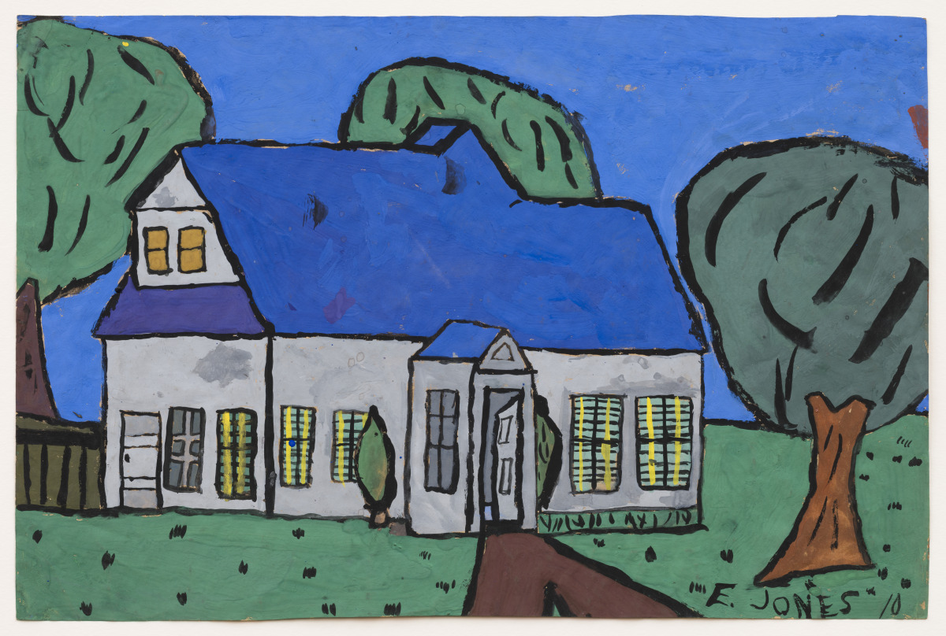

Slide 7
Questions for Looking
At age 10, Emmett Erskine Jones painted this image of the LeMoyne Art Center, where he took art classes. We see the building from the outside. Imagine what is happening inside. What events or activities might be taking place? Share ideas with a partner.
Look closely at this picture. List words to describe what you see, such as colors, shapes, and details.
What time of day do you imagine it is in this picture? What do you see that makes you say that?
Emmett Erskine Jones, American, 1928–2018; The Art Center, 1938; poster paint on brown paper; 12 1/2 x 18 1/4 inches; Saint Louis Art Museum, Gift of the Federal Works Agency, Work Projects Administration 382:1943
Created by youth artist at the LeMoyne Federal Art Center in Memphis, Tennessee

Slide 8
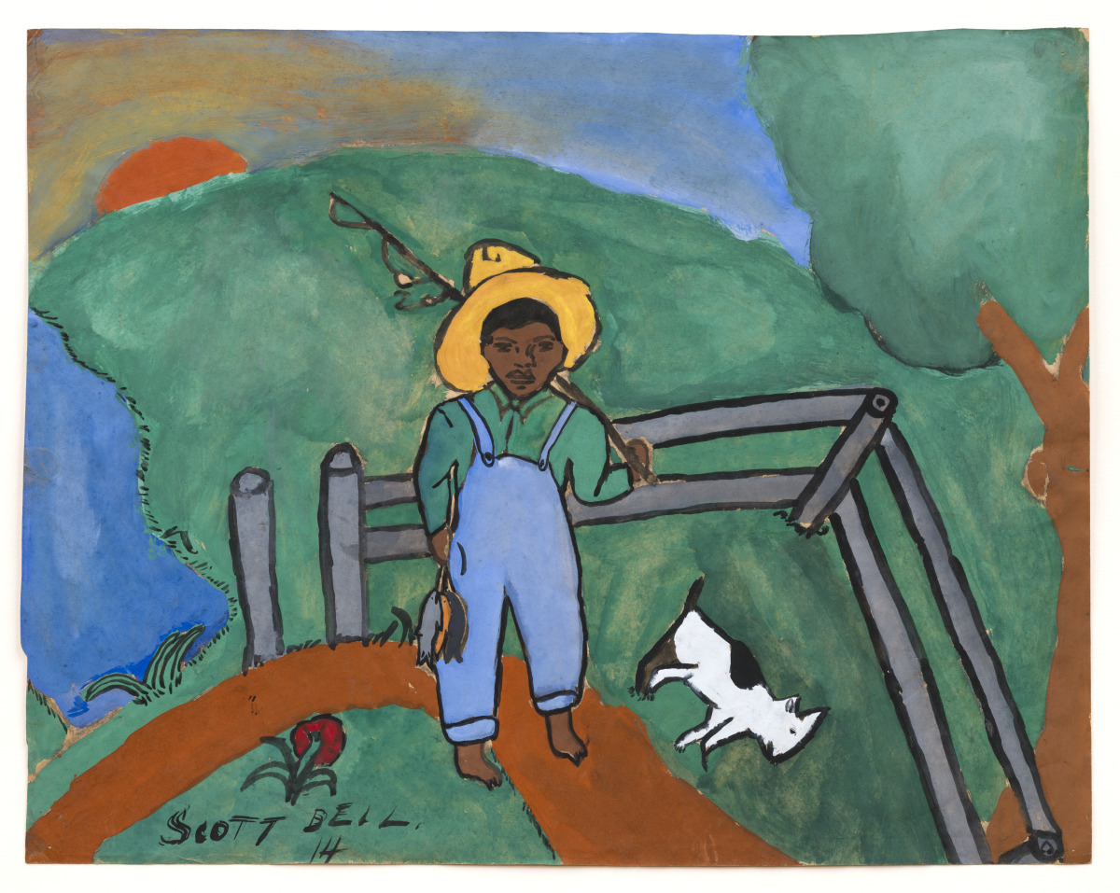

Slide 9
Questions for Looking
The title of this work is Bin Fishin. The artist painted a figure outdoors. What are some activities that you like to do outside?
As you look at this person, what do you imagine they might be feeling in this moment? What do you see that makes you say that? Share your ideas with a classmate.
The figure is holding a fishing pole. What tools do you use every day? How do those tools help you complete tasks?
This painting may be a self-portrait of the artist. If you were to create your own self-portrait, how would you paint yourself? Draw your self-portrait. Think about what expression you would have on your face and what clothes you would wear.
Scott Bell Jr., American, 1924–1984; Bin Fishin, 1938; poster paint on brown paper; 14 1/4 x 18 inches; Saint Louis Art Museum, Gift of the Federal Works Agency, Work Projects Administration 367:1943
Created by youth artist at the LeMoyne Federal Art Center in Memphis, Tennessee

Slide 10
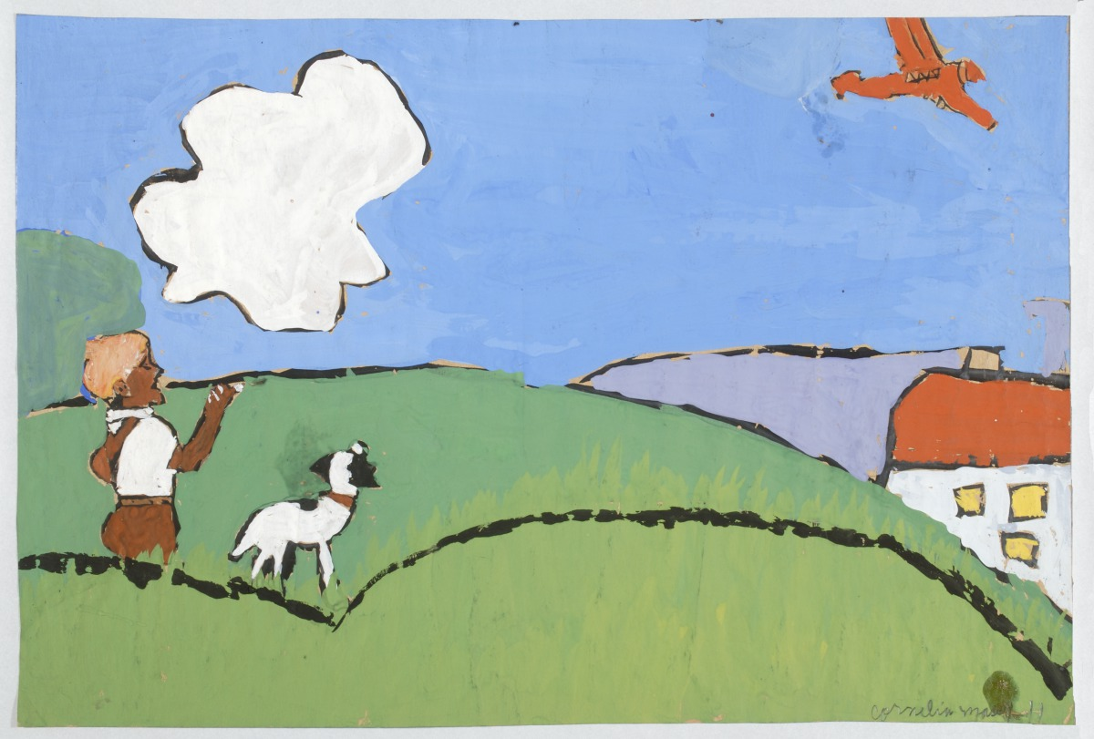

Slide 11
Questions for Looking
Begin by exploring this picture using some of your senses: sound, smell, sight, taste, touch. Choose one card from the set of sensory cards to guide your exploration. Then choose another card to explore with a different one of your senses.
Look closely at the image again. What is going on in this painting? What do you see that makes you say that?
What is the farthest place you have travelled to from where you live? Who did you travel with?
If you could fly anywhere in the world, where would you go? What adventures would you enjoy?
If you could bring an animal or pet with you to a new destination, what activities would you try together?
Cornelia Massey, American, 1926–2018; Boy Showing Dog Airplane, 1938; poster paint on brown paper; 12 x 18 inches; Saint Louis Art Museum, Gift of the Federal Works Agency, Work Projects Administration 386:1943
Created by youth artist at the LeMoyne Federal Art Center in Memphis, Tennessee

Slide 12
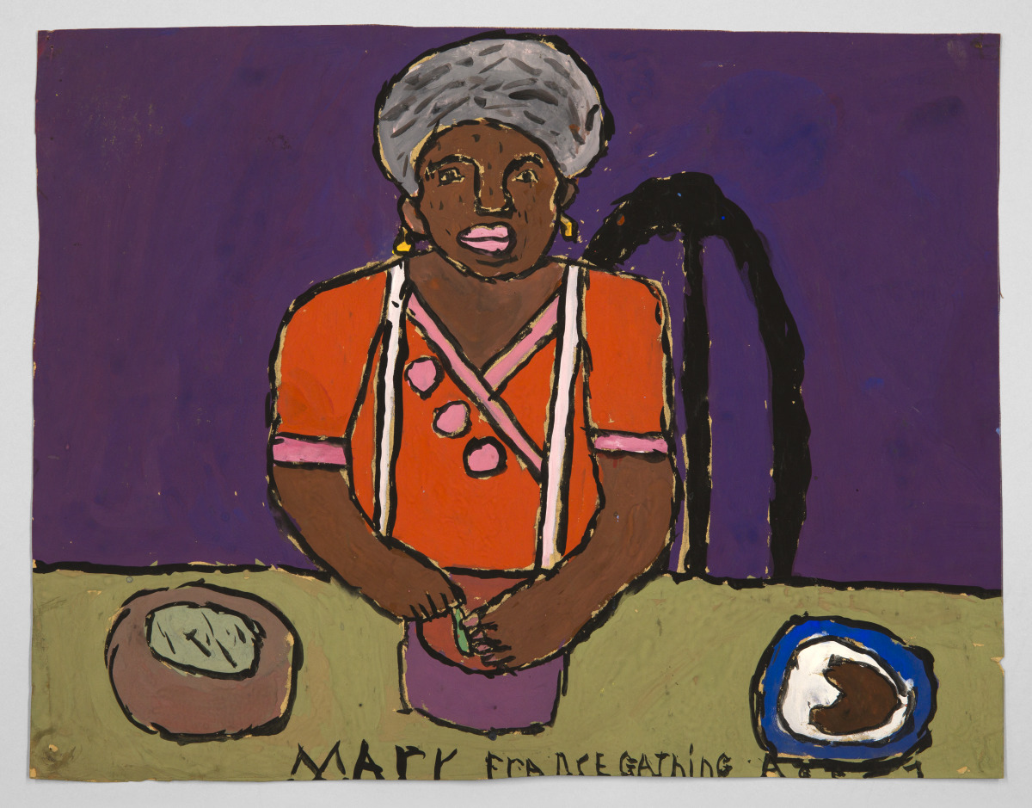

Slide 13
Questions for Looking
Imagine you are sitting across from the person pictured in this painting. What questions would you like to ask them? Write or share two questions.
This person may be making dinner for herself and possibly others. What is one thing that you like to do for others? (For example: share a snack, make a card to wish them a happy birthday.)
Imagine you could fill the bowl on the table with your favorite food. What would you like to fill it with? On your paper, draw a picture of the bowl full of the food(s) you have chosen.
Mary Frances Gathings, American, 1931–1995; Woman Preparing Supper, 1938; poster paint on brown paper; 12 1/4 x 15 7/8 inches; Saint Louis Art Museum, Gift of the Federal Works Agency, Work Projects Administration 375:1943
Created by youth artist at the LeMoyne Federal Art Center in Memphis, Tennessee

Slide 14
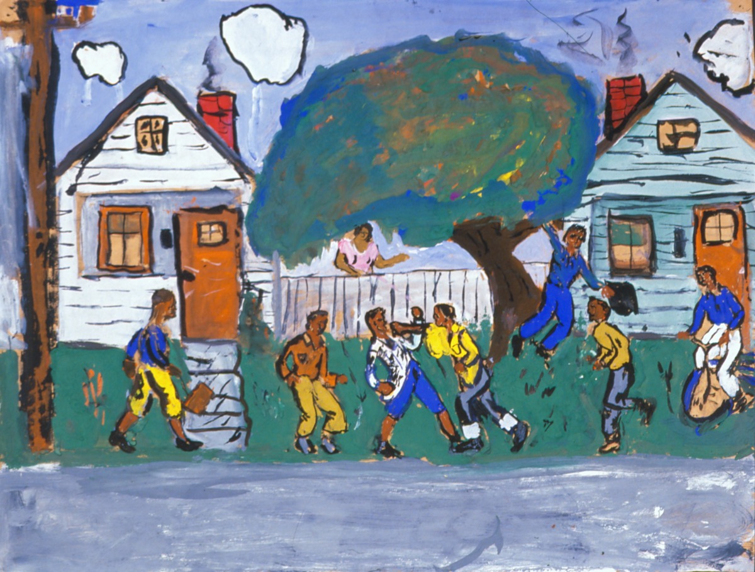

Slide 15
Questions for Looking
Begin by exploring this picture using some of your senses: sound, smell, sight, taste, touch. Choose one card from the set of sensory cards to guide your exploration. Then choose another card to explore with a different one of your senses.
Each person brings something special to the scene. Choose one person in the picture. Imagine what this person might be saying. Move the speech bubble icon (included in the online resource) to the figure that you chose. Share your ideas with the group. Then pass the speech bubble icon to another member of the group for them to share.
The title of this artwork is After School. What is your favorite after school activity? Share your favorite activity with a classmate or in a group.
Robert Louis Franklin Jr., American, 1928–2005; After School, 1938; poster paint on brown paper; 18 x 23 5/8 inches; Saint Louis Art Museum, Gift of the Federal Works Agency, Work Projects Administration 400:1943
Created by youth artist at the LeMoyne Federal Art Center in Memphis, Tennessee

Slide 16
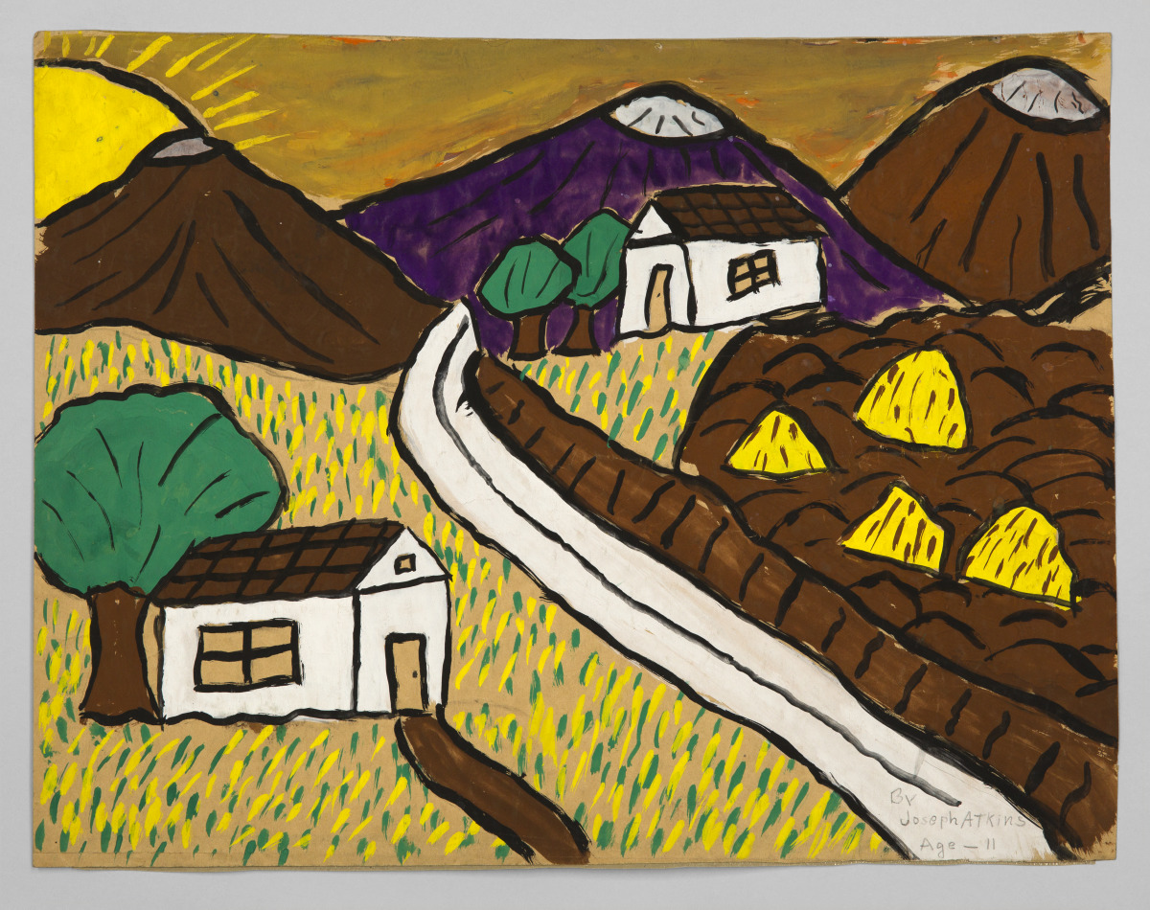

Slide 17
Questions for Looking
Imagine you were to jump into this image and go on an adventure in this place. What would you bring to help you on your adventure?
Using the icon card provided, choose three things you would bring with you on your adventure. Share with the other classmates at your table. Use your icons to tell a story of what you would do on your adventure in this landscape.
Joseph Percy Atkins, American, 1927–1999; Landscape, 1938; poster paint on brown paper; 13 1/2 x 18 inches; Saint Louis Art Museum, Gift of the Federal Works Agency, Work Projects Administration 365:1943
Created by youth artist at the LeMoyne Federal Art Center in Memphis, Tennessee

Slide 18
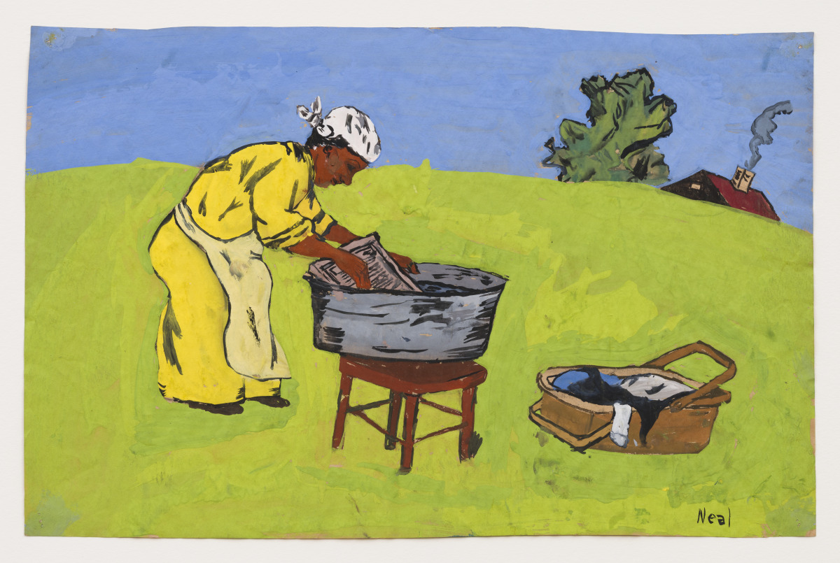

Slide 19
Questions for Looking
Imagine the items in this painting are musical instruments. Which item would you choose to play? How might you play it?
Looking at the figure, imagine what might happen next in their day. Draw a picture or write a short story to share your ideas.
On your paper, write a question that you would ask the artist to help you understand more about the story or idea behind this artwork.
Harold Lloyd Neal, American, 1924–1996; Wash Day, 1938; poster paint on brown paper; 12 x 18 inches; Saint Louis Art Museum, Gift of the Federal Works Agency, Work Projects Administration 393:1943
Created by youth artist at the LeMoyne Federal Art Center in Memphis, Tennessee

Slide 20
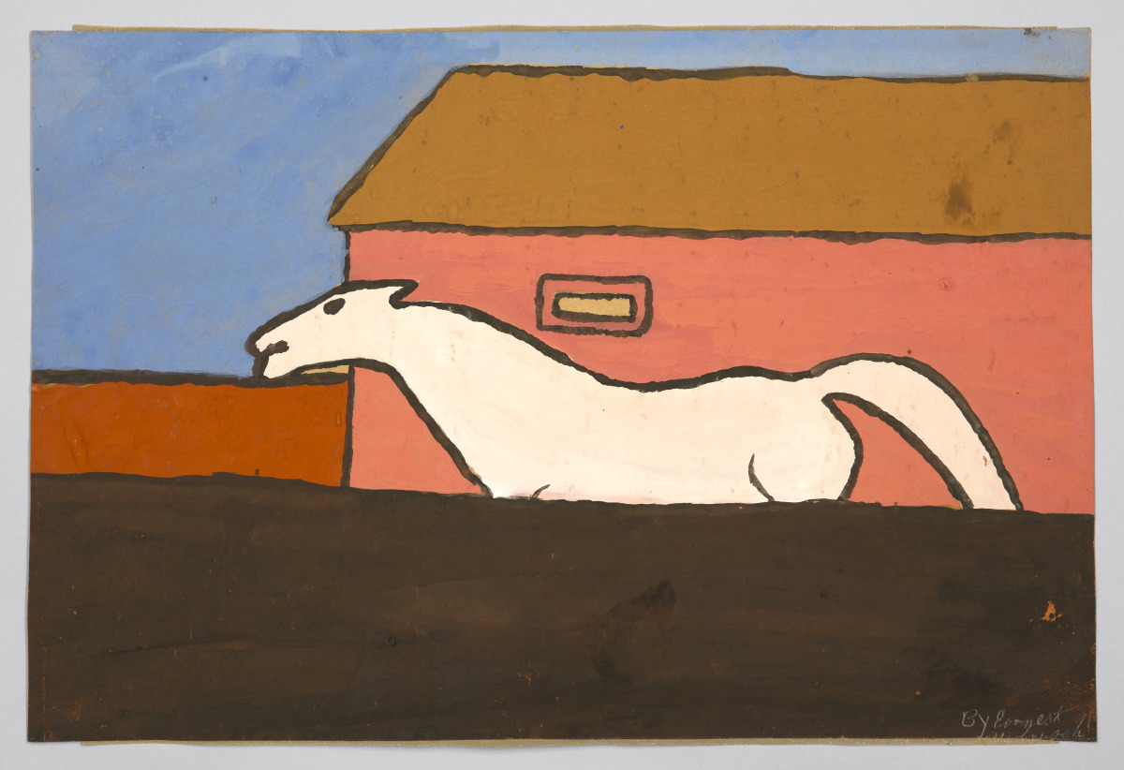

Slide 21
Questions for Looking
Explore this image using the sensory card “sight.”
As you look closely at this horse, imagine that it is in motion. Is this horse moving quickly or slowly? What do you see that makes you say that?
If you could hop onto the back of this horse, what more might you discover around you in this place?
Earnest Yarbrough, American, 1923–1980; White Horse, 1938; poster paint on brown paper; 12 1/8 x 18 1/2 inches; Saint Louis Art Museum, Gift of the Federal Works Agency, Work Projects Administration 403:1943
Created by youth artist at the LeMoyne Federal Art Center in Memphis, Tennessee

Slide 22
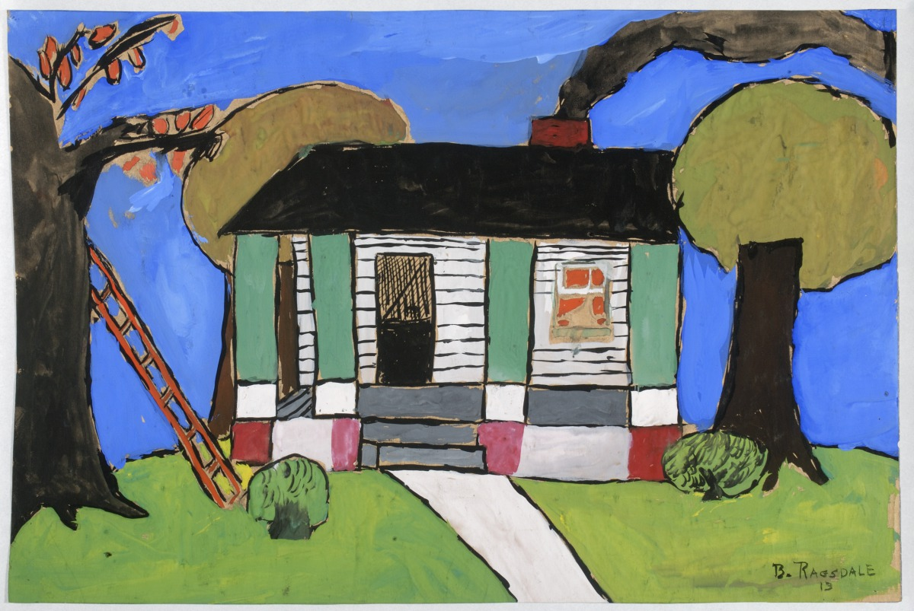

Slide 23
Questions for Looking
On the left side of the painting, there is a ladder that leans against a tree. Imagine if you were to climb the ladder. Where would the ladder take you?
As you look at this image, what season of the year do you imagine it is? What do you see that makes you say that?
If you could create your own title for this artwork, what would you call it? What do you see that inspires your title?
Byron Gilbert Ragsdale, American, 1925–1996; Landscape with Trees, 1938; poster paint on brown paper; 12 x 18 inches; Saint Louis Art Museum, Gift of the Federal Works Agency, Work Projects Administration 399:1943
Created by youth artist at the LeMoyne Federal Art Center in Memphis, Tennessee

Slide 24
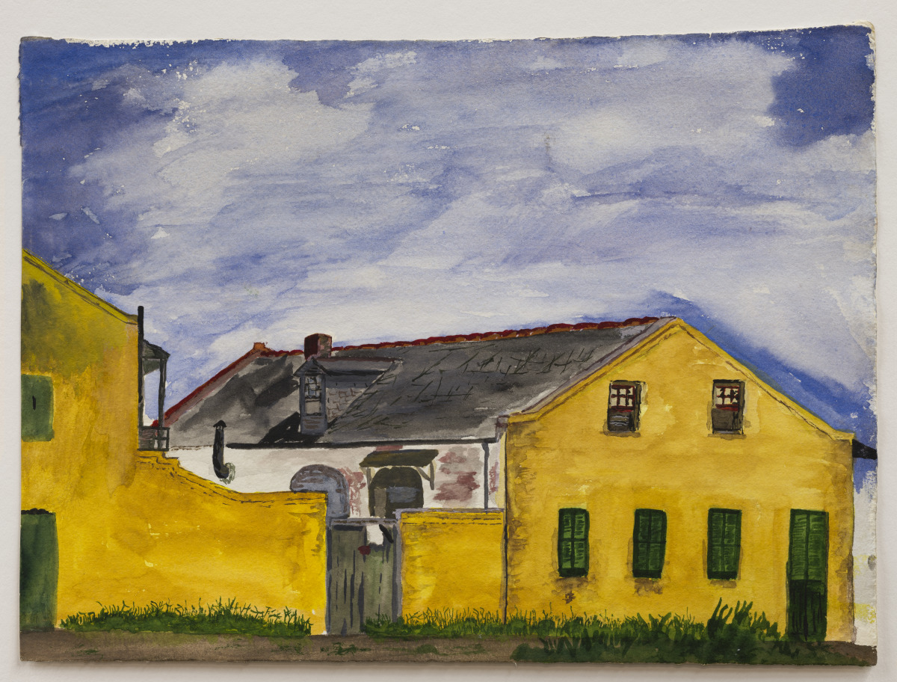

Slide 25
Questions for Looking
Choose one word to describe the feeling (mood) of this artwork.
If you could paint this house a different color, what color would you choose? Why? How might your new color change the felling (mood) of the artwork?
The space above the yellow house appears quiet. Use your imagination to design an active sky. Consider the weather, flying animals (fantastic or realistic), planes, or even fireworks that you could add to the scene.
Joseph Thomas Williams, American, 1916–1976; Yellow House, 1940; watercolor; sheet: 8 5/8 x 11 3/4 inches; Saint Louis Art Museum, Gift of the Federal Works Agency, Work Projects Administration 346:1943

Slide 26
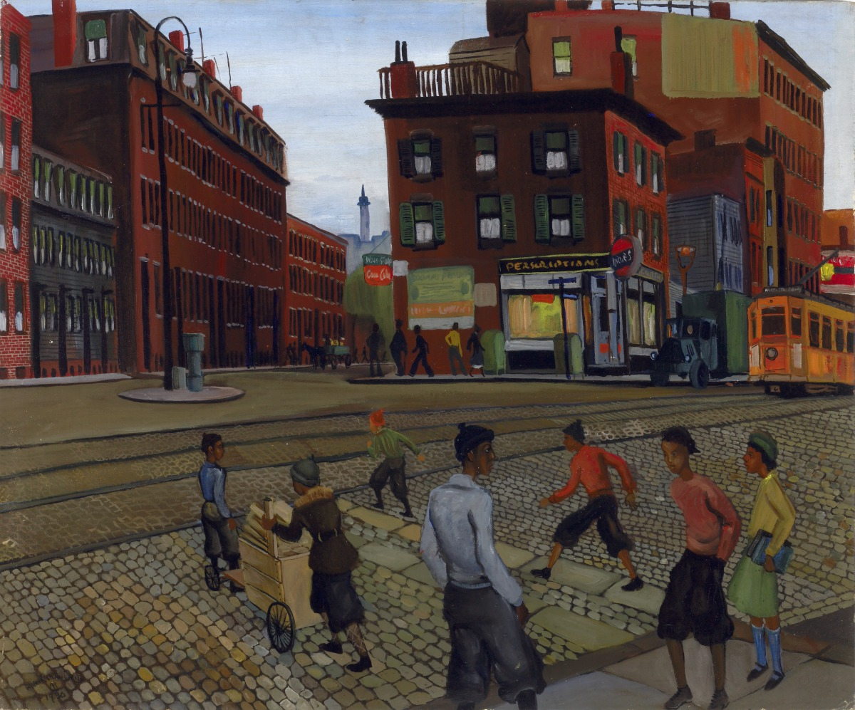

Slide 27
Questions for Looking
Begin by exploring this picture using some of your senses (sound, smell, sight, touch, taste). Choose one card from the set of sensory cards to guide your exploration. Then try a different sensory card to discover more.
Choose one person from the painting. Where do you imagine they might be going next? What do you see that makes you say that?
The painting is called Douglass Square. If you could teleport to Douglass Square, where in this scene would you want to land? Why? What kind of adventures might you have in this location?
Allan Rohan Crite, American, 1910–2007; Douglass Square, 1936; oil on canvas-covered artist's board; 23 1/2 x 27 inches; Saint Louis Art Museum, Gift of the Federal Works Agency, Work Projects Administration 354:1943

Slide 28
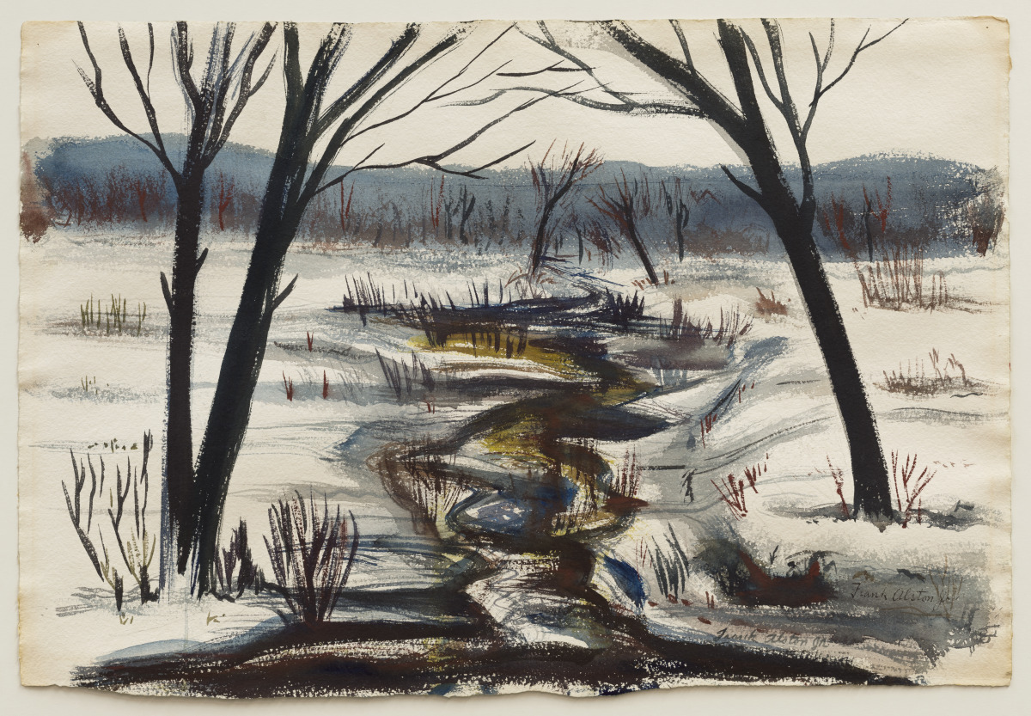

Slide 29
Questions for Looking
What clothing would you choose to wear if you were in this landscape? What do you see that makes you say that?
What can you find in the picture that could help to build a snow sculpture? What type of sculpture might you build? Draw a picture or share your ideas with a classmate.
What are your favorite winter activities? Which activity could you enjoy in this place?
Frank Herman Alston Jr., American, 1913–1978; Rhode Island Landscape, 1939; watercolor over graphite; 15 3/4 × 22 11/16 in. (40 × 57.6 cm) framed: 24 3/4 × 32 × 1 1/4 in. (62.9 × 81.3 × 3.2 cm); Saint Louis Art Museum, Gift of the Federal Works Agency, Work Projects Administration 347:1943

Slide 30
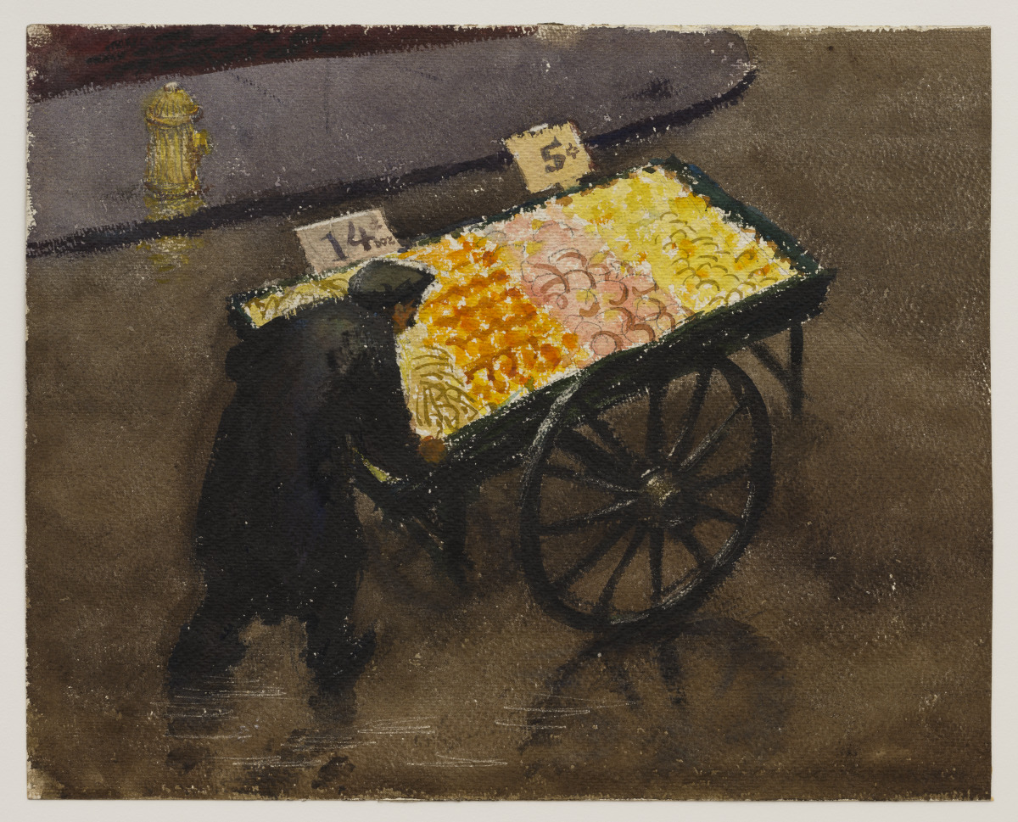

Slide 31
Questions for Looking
This artwork is titled Fruit in the Rain. What is an activity you like to do in the rain? Write a sentence about your activity.
In the picture, a figure stands near a cart filled with fruits. If the cart contained your favorite fruits, what would we find?
If you could add or remove one object from this rainy scene, what would it be? Draw and share your changes.
Joseph Hirsch, American, 1910–1981; Fruit in the Rain, about 1938; watercolor over graphite, with scraped highlights; 14 1/4 x 17 7/8 in. (36.2 x 45.4 cm); Saint Louis Art Museum, Gift of the Federal Works Agency, Work Projects Administration 290:1943

Slide 32
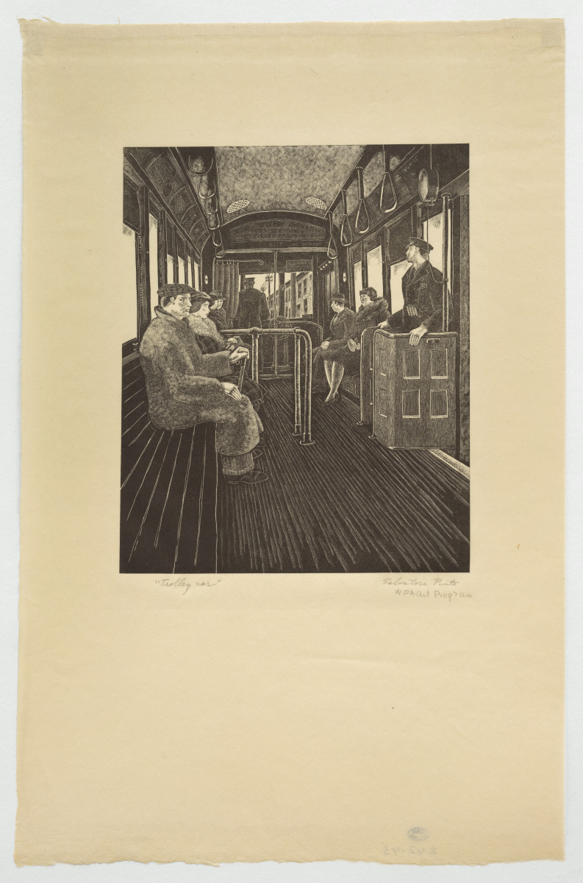
(Detail)

Slide 33
Questions for Looking
Choose where you would sit in this trolley car. What might you discover as you look around from your seat? What do you see that makes you say that?
If you could talk to one person in the picture, who would you choose? Why?
Place the speech bubble icon above the person you have chosen. Imagine a conversation you would have. What would you talk about?
On your paper, write a short conversation between yourself and the individual on the trolly car. Or, find a friend or classmate to act out your conversation.
Salvatore Pinto, American (born Italy), 1905–1966; Trolley Car, about 1936–41; wood engraving; plate: 8 1/2 × 6 3/4 in. (21.6 × 17.1 cm) sheet: 16 5/8 × 10 1/2 in. (42.2 × 26.7 cm); Saint Louis Art Museum, Gift of the Federal Works Agency, Work Projects Administration 242:1943

Slide 34
Create
Your Own Postcard
Art
The artworks in this resource all explore different neighborhoods and activities that artists (of all ages) lived in and engaged with. Now, let’s think about our own unique stories.
What are the places, people, or activities that are special to you?
Design a postcard to share something with someone who lives outside your neighborhood. Have fun and be creative. Feel free to cut, bend, fold, or tear the postcard. You might even want to try adding words or materials that you find to your postcard.

